Slide 1

Sentiment Analysis of Twitter Data for predicting Apple stock price movements
Group4
Amit Sharma, Mihir Mehta, MANJARI SHUKLA, Richard Yoo

Slide 2
SUMMARY
This project analyzes whether social media, representative of public sentiment affects the movement in stock price
Core Message
To analyze how Twitter sentiment affects the movement in price of Apple stock (“APPL”)

Slide 3
Model Summary
Regressor Approach
LSTM
Random Forest Regressor
XG Boost
Classification Approach
Random Forest Classifier
Gradient Booster

Slide 4

Data Used
Twitter Data: Data from Kaggle(https://www.kaggle.com/nadun94/twitter-sentiments-aapl-stock)
Stock Data: Stock Prices of Apple from Yahoo Finance.
Machine Learning Models: Time Series Models, LSTM and XG Boost to fit the data and compare performance between models.
Data Visualization: hvPlot and Matplotlib.

Slide 5

Problem/issues during data prep and model training
Data preparation:
1) Getting APPL stock data
2) Getting Twitter Data using Tweepy Library
3) Getting Twitter Data with “ts_polarity” and “twitter_volume”
Model Training:
1) Selecting ideal window size
2) window_data function
3) Model fitting

Slide 6
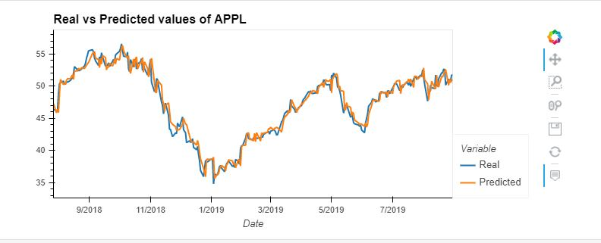
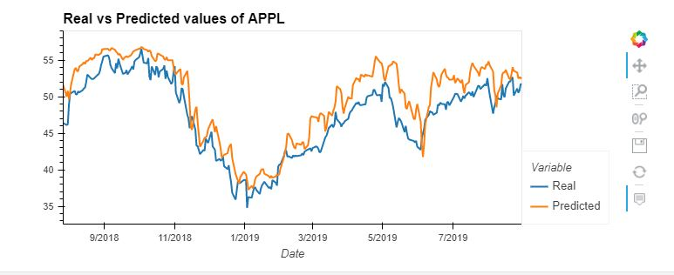
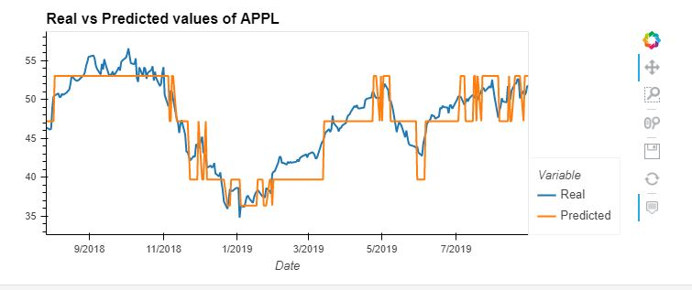
Model Training Process/Techniques
XG Boost
LSTM
RF Regressor

Slide 7
Summary/Conclusions/Predictions
Was the model sufficient for the predictive task?
What inferences or general conclusions can you draw from your model performance?

Slide 8
Postmortem
Any Difficulties?
Finding Data
Data Cleaning
Machine Learning Models
What would you research next, if you had two more weeks?
Tweepy API/Library
More Machine Learning Models
More visualizations

Slide 9
Q&A

